Slide 1





Relations and Functions
Chapter 5
1 to 1
many to many
1 to many

Slide 2

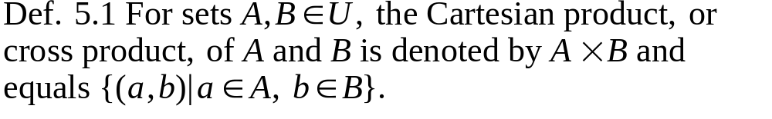

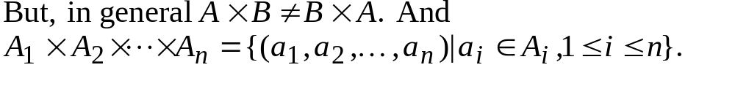
Chapter 5 Relations and Functions
5.1 Cartesian Products and Relations
the elements of A B are ordered pairs
|A B|=|A| |B|=|B A|

Slide 3
Chapter 5 Relations and Functions
5.1 Cartesian Products and Relations
Ex. 5.3 The sample space by rolling a die first then flipping a coin
Tree structure
1
2
3
4
5
6
1,H 1,T 2,H 2,T 3,H 3,T 4,H 4,T 5,H 5,T 6,H 6,T
={1,2,3,4,5,6} {H,T}

Slide 4
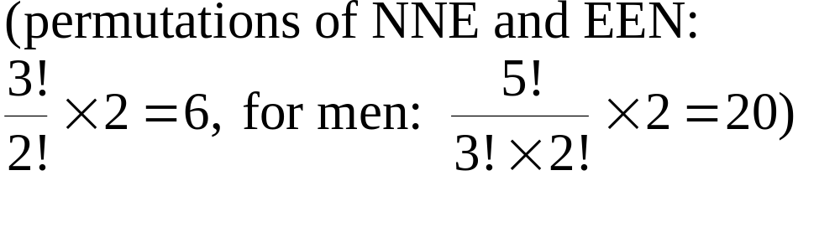
Chapter 5 Relations and Functions
5.1 Cartesian Products and Relations
Trees are convenient tools for enumeration.
Ex. 5.4 At the Wimbledon Tennis Championships, women play
at most 3 sets in a match. The winner is the first to win two sets.
In how many ways can a match be won?
N
N
N
E
E
N
N
E
E
E
Therefore, 6 ways.

Slide 5
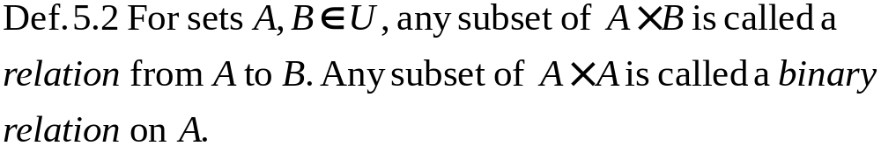
Chapter 5 Relations and Functions
5.1 Cartesian Products and Relations
In general, for finite sets A,B with |A|=m and |B|=n, there
are 2^{mn} relations from A to B, including the empty relation
as well as the relation A B itself.
Ex. 5.7 A=Z⁺, a binary relation, R, on A, {(x,y)|x<y}
(1,2), (7,11) is in R, but (2,2), (3,2) is not in R
or 1R2, 7R11 (infix notation)

Slide 6
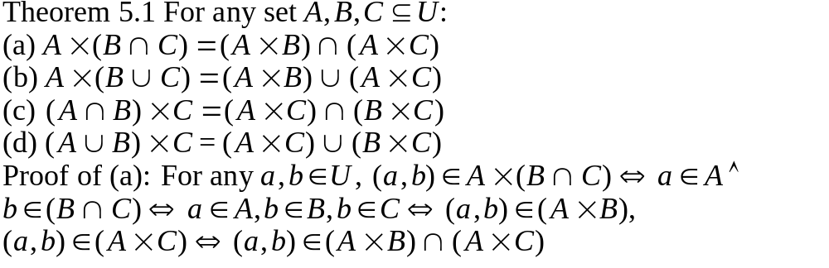
Chapter 5 Relations and Functions
5.1 Cartesian Products and Relations

Slide 7

Chapter 5 Relations and Functions
5.2 Functions: Plain and One-to-One
Def. 5.3 For nonempty sets, A,B, a function, or mapping, f from
A to B, denoted f:A B, is a relation from A to B in which every
element of A appears exactly once as the first component of an
ordered pair in the relation.
not allowed
set A
set B

Slide 8
Chapter 5 Relations and Functions
5.2 Functions: Plain and One-to-One
Def 5.4 Domain, Codomain, Range
A
B
f(a)=b
range
b
a
domain
codomain

Slide 9
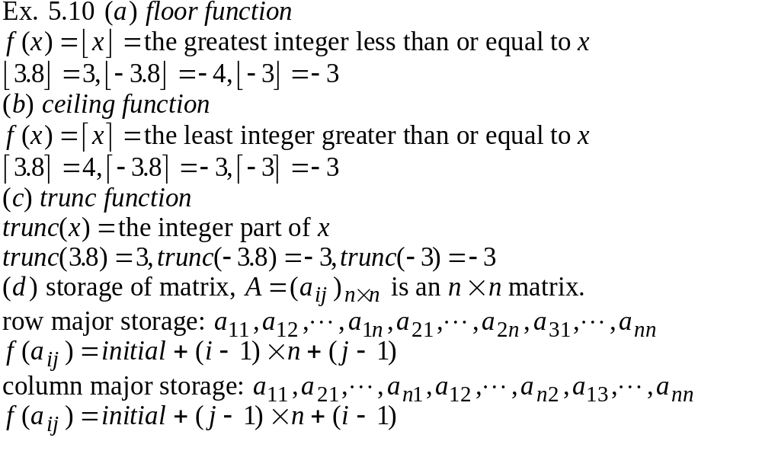
Chapter 5 Relations and Functions
5.2 Functions: Plain and One-to-One

Slide 10
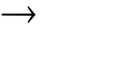
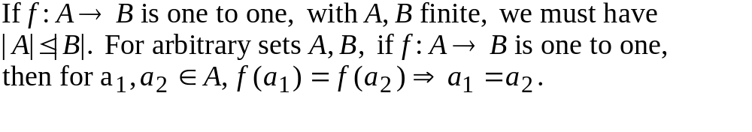
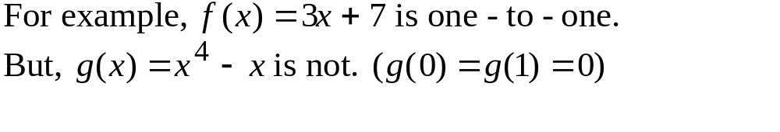
Chapter 5 Relations and Functions
5.2 Functions: Plain and One-to-One
If |A|=m, |B|=n, then the number of possible functions from A
to B is n^{m}.
Def 5.5 A function f:A B is called one-to-one, or injective, if
each element of B appears at most once as the image of an
element of A.

Slide 11
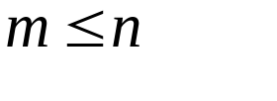
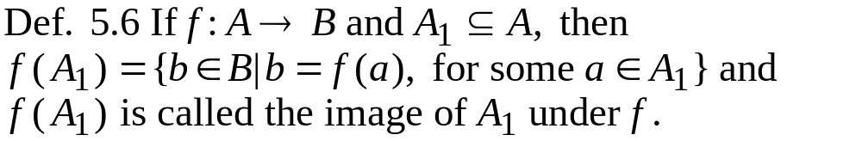
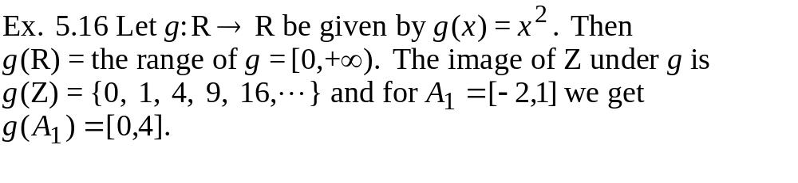
Chapter 5 Relations and Functions
5.2 Functions: Plain and One-to-One
If |A|=m, |B|=n, and , then the number of one-to-one functions
from A to B is P(n,m)=n!/(n-m)!.

Slide 12
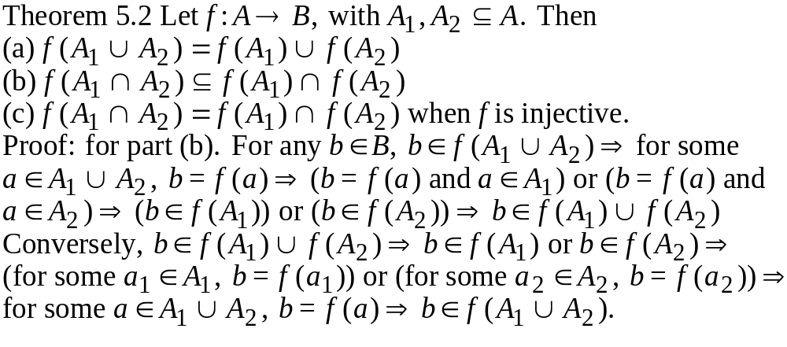
Chapter 5 Relations and Functions
5.2 Functions: Plain and One-to-One
1
2
3
a
b

Slide 13
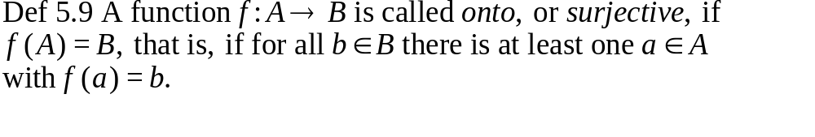
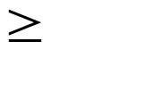
Chapter 5 Relations and Functions
5.3 Onto Functions: Stirling Number of the Second Kind
Ex 5.19 f:R R defined by f(x)=x³ is onto. But f(x)=x² is not.
Ex. 5.20 f:Z Z where f(x)=3x+1 is not onto.
g:Q Q where g(x)=3x+1 is onto.
h:R R where h(x)=3x+1 is onto.
If A,B are finite sets, then for any onto function f:A B to
possibly exist we must have |A| |B|. But how many onto
functions are there?

Slide 14
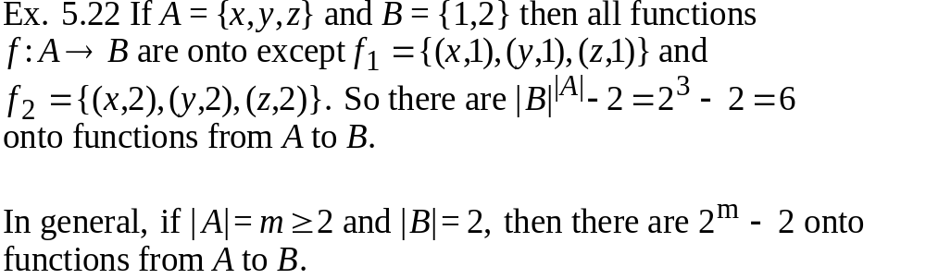
Chapter 5 Relations and Functions
5.3 Onto Functions: Stirling Number of the Second Kind

Slide 15
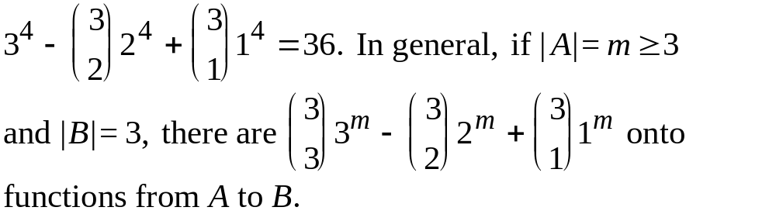
Chapter 5 Relations and Functions
5.3 Onto Functions: Stirling Number of the Second Kind
Ex. 5.23 For A={w,x,y,z} and B={1,2,3}, there are 3⁴ functions
from A to B. Among all functions:
(1) {1} is not mapped: 2⁴ functions from A to {2,3}
(2) {2} is not mapped: 2⁴ functions from A to {1,3}
(1) {3} is not mapped: 2⁴ functions from A to {1,2}
But the functions A to {1} or {2} or {3} are all counted twice.
Therefore, number of onto functions from A to B is
(What about m=1 or m=2?)

Slide 16
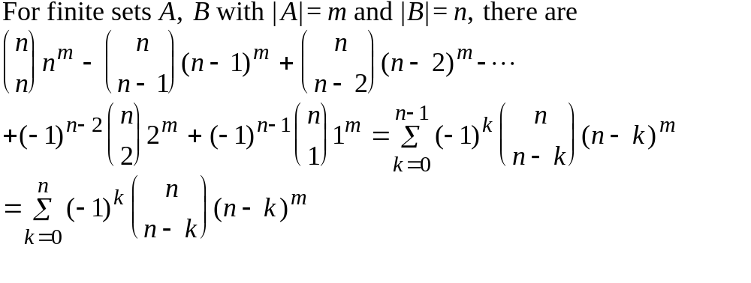
Chapter 5 Relations and Functions
5.3 Onto Functions: Stirling Number of the Second Kind
General formula

Slide 17
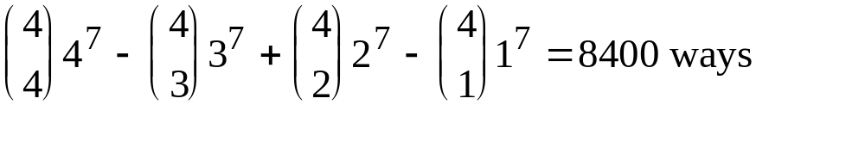
Chapter 5 Relations and Functions
5.3 Onto Functions: Stirling Number of the Second Kind
Examples at the beginning of this chapter (P217)
(1) seven contracts to be awarded to 4 companies such that every
company is involved?
(2) How many seven-symbol quaternary (0,1,2,3) sequences have at
least one occurrence of each of the symbols 0,1,2, and 3?
(3) How many 7 by 4 zero-one matrices have exactly one 1 in each
row and at least one 1 in each column?

Slide 18
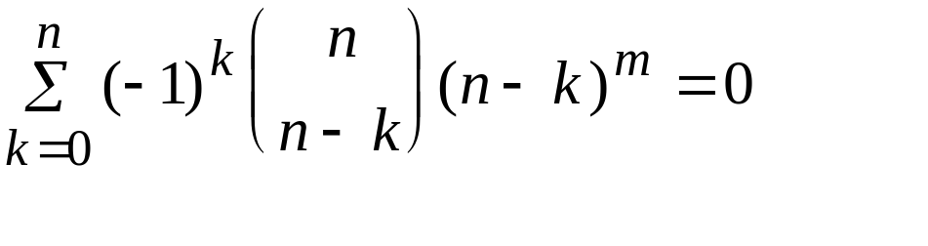
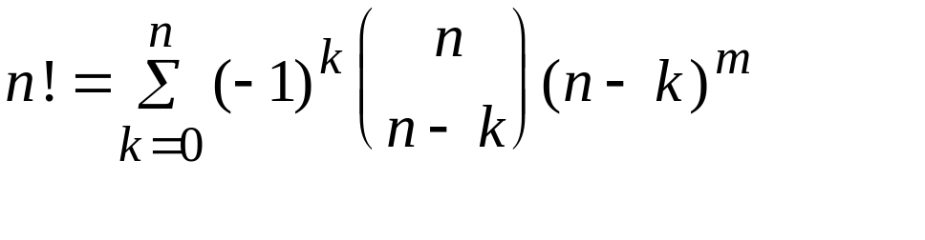
Chapter 5 Relations and Functions
5.3 Onto Functions: Stirling Number of the Second Kind
Examples at the beginning of this chapter (P217)
(4) Seven unrelated people enter the lobby of a building which has
four additional floors, and they all get on an elevator. What is
the probability that the elevator must stop at every floor in order
to let passengers off? 8400/4⁷=8400/16384>0.5
(5) For positive integers m,n with m<n, prove that
(6) For every positive integer n, verify that

Slide 19
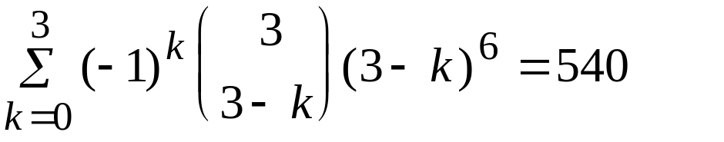
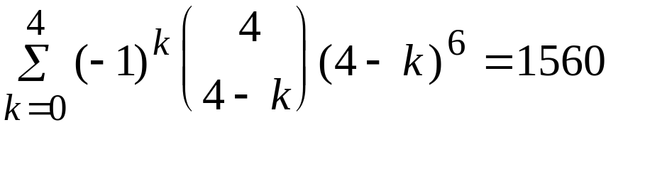
Chapter 5 Relations and Functions
5.3 Onto Functions: Stirling Number of the Second Kind
Ex. 5.25 7 jobs to be distributed to 4 people, each one gets at least
one job and job 1 is assigned to person 1.
Ans:
case 1: person 1 gets only job 1
onto functions from 6 elements to 3 elements (persons)
case 2: person1 gets more than one job
onto functions from 6 elements to 4 elements (persons)
540+1560

Slide 20
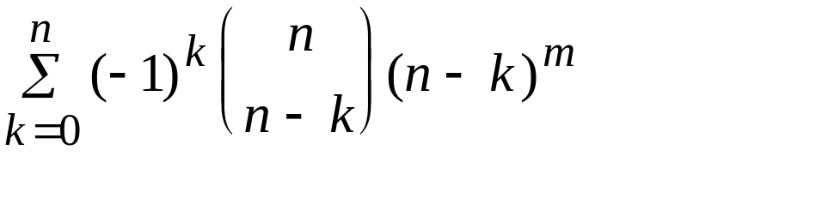
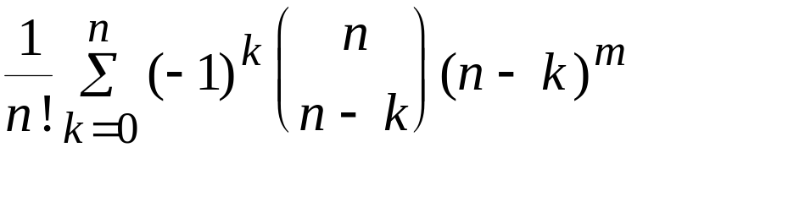
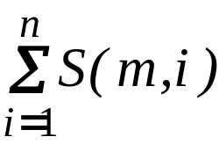
Chapter 5 Relations and Functions
5.3 Onto Functions: Stirling Number of the Second Kind
The number of ways to distribute m distinct objects into n
different containers with no container left empty is
If the containers are identical:
S(m,n): Stirling number of the second kind
n!S(m,n) onto functions
Ex. 5.27 distribute m distinct objects into n identical containers
with empty containers allowed

Slide 21
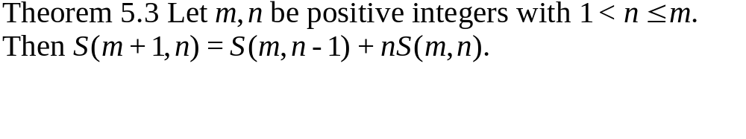


Chapter 5 Relations and Functions
5.3 Onto Functions: Stirling Number of the Second Kind
Proof:
S(m+1,n)
n identical containers
a_{m+1} is alone in one container
a_{m+1} is not alone in one container
Distribute other n objects first
into n containers. Then a_{m+1} can
be put into one of them.
S(m,n-1)
nS(m,n)

Slide 22
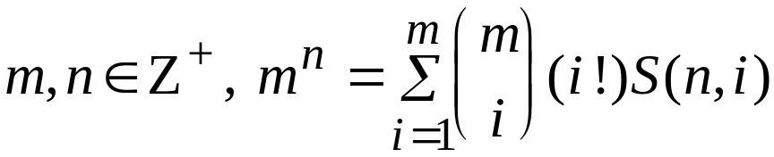
Chapter 5 Relations and Functions
5.3 Onto Functions: Stirling Number of the Second Kind
Ex. 5.28 How many ways to factorize 30030 into at least two
factors (greater than 1) where order is not relevant?
Ans:
There are at most 6 factors.
Therefore, the answer is S(6,2)+ S(6,3)+S(6,4)+S(6,5)+S(6,6)=202
Ex. Prove that for all
Proof: m^{n}: ways to distribute n distinct objects into m distinct containers
i!S(n,i): ways to distribute n distinct objects into i distinct containers
with no empty containers

Slide 23
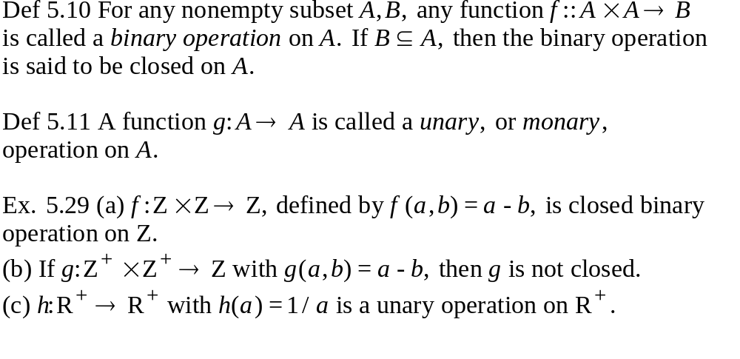
Chapter 5 Relations and Functions
5.4 Special Functions

Slide 24
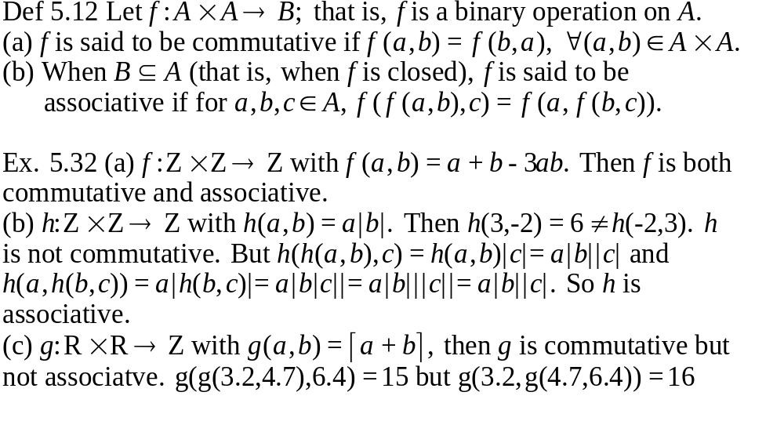
Chapter 5 Relations and Functions
5.4 Special Functions

Slide 25
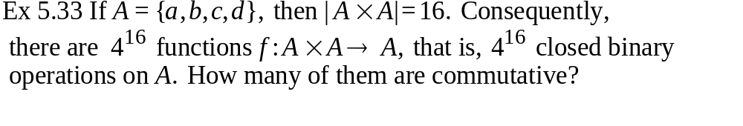

Chapter 5 Relations and Functions
5.4 Special Functions
a b c d
Therefore,
a
b
c
d
4⁶
6 entries
4⁴

Slide 26
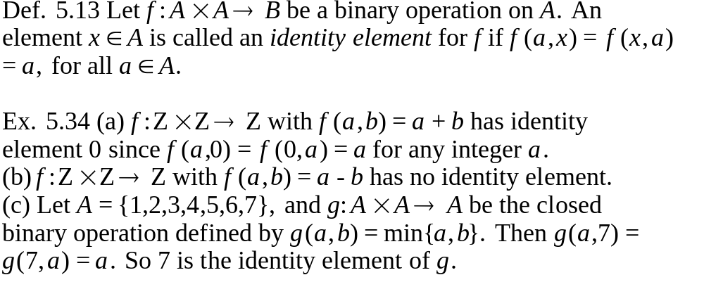
Chapter 5 Relations and Functions
5.4 Special Functions

Slide 27
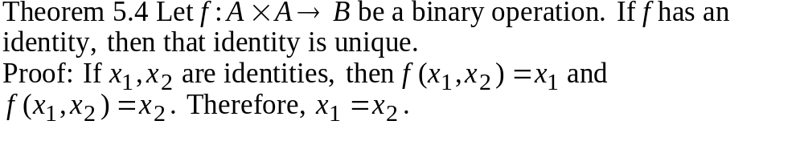
Chapter 5 Relations and Functions
5.4 Special Functions
identity
identity

Slide 28
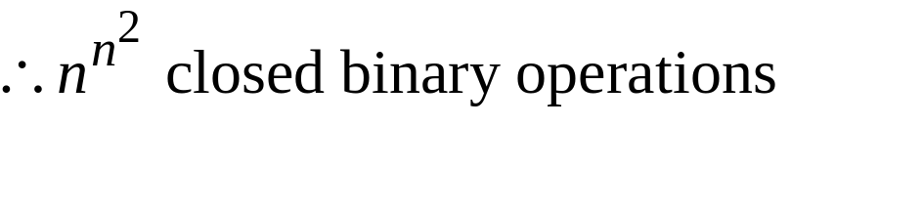
Chapter 5 Relations and Functions
5.4 Special Functions
a₁ a₂ a₃ . . . a_{n}
a₁
a₂
a₃
.
.
.
a_{n}
n² entries, each has n choices

Slide 29
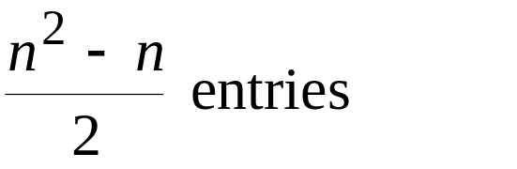
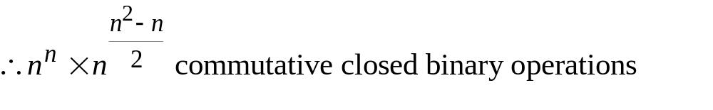
Chapter 5 Relations and Functions
5.4 Special Functions
a₁ a₂ a₃ . . . a_{n}
a₁
a₂
a₃
.
.
.
a_{n}
n entries

Slide 30
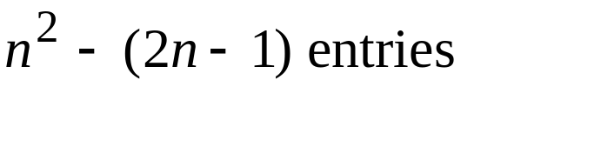
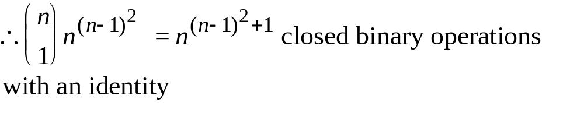
Chapter 5 Relations and Functions
5.4 Special Functions
If a₁ is the identity
a₁ a₂ a₃ . . . a_{n}
a₁
a₂
a₃
.
.
.
a_{n}
a₁
a₂
a₃
.
.
.
a_{n}
a₂ a₃ . . . a_{n}

Slide 31
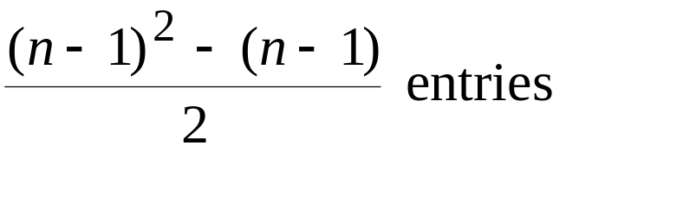
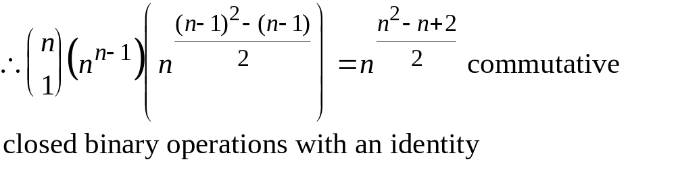
Chapter 5 Relations and Functions
5.4 Special Functions
If a₁ is the identity
a₁ a₂ a₃ . . . a_{n}
a₁
a₂
a₃
.
.
.
a_{n}
a₁
a₂
a₃
.
.
.
a_{n}
a₂ a₃ . . . a_{n}
n-1 entries

Slide 32
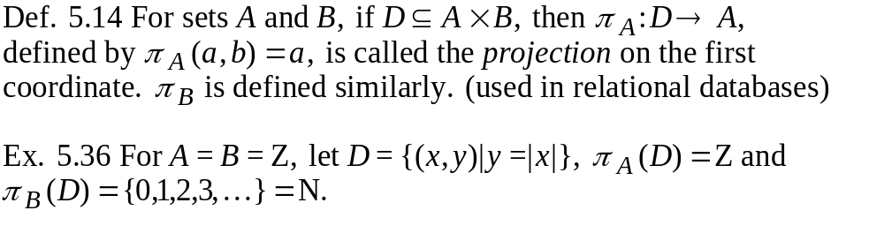
Chapter 5 Relations and Functions
5.4 Special Functions

Slide 33
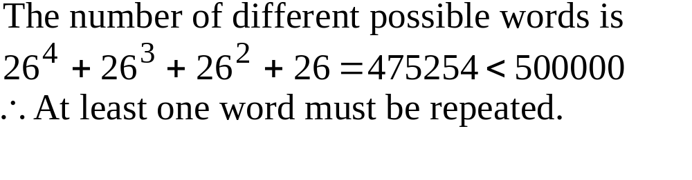
Chapter 5 Relations and Functions
5.5 The Pigeonhole Principle
The Pigeonhole Principle: If m pigeons occupy n pigeonholes and
m>n, then at least one pigeonhole has two or more pigeons
roosting in it.
For example, of 3 people, two are of the same sex. Of 13 people,
two are born in the same month.
Ex. 5.42 A tape contains 500,000 words of four or fewer lower
lowercase letters. Can it be that they are all different?

Slide 34
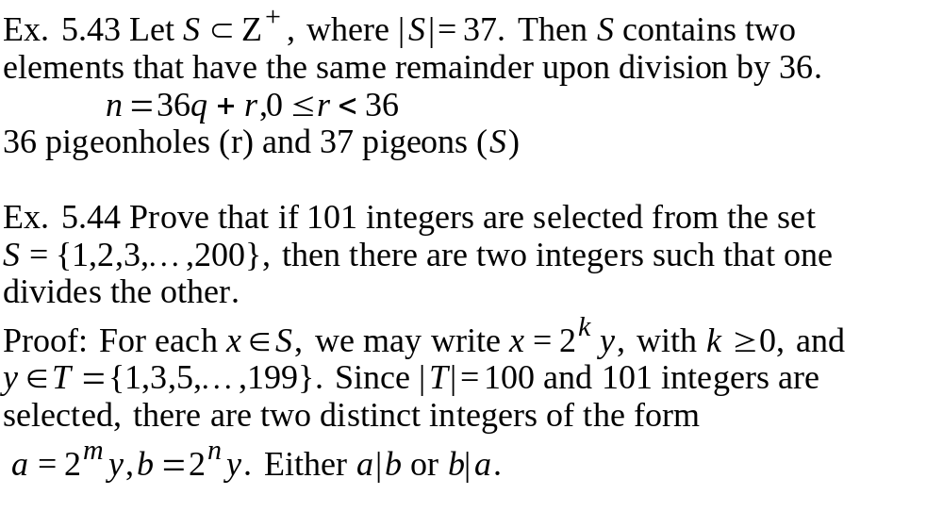
Chapter 5 Relations and Functions
5.5 The Pigeonhole Principle

Slide 35
Chapter 5 Relations and Functions
5.5 The Pigeonhole Principle
Ex. 5.44 Any subset of size six from the set S={1,2,3,...,9} must
contain two elements whose sum is 10.
pigeonholes: {1,9},{2,8},{3,7},{4,6},(5}
pigeons: six of them
Therefore, at two elements must be from the same subset.
Ex. 5.45 Triangle ACE is equilateral with AC=1. If five points are
selected from the interior of the triangle, there are at least two whose
distance apart is less than 1/2.
5 pigeons
region 1
region 2
region 3
region 4
4 pigeonholes

Slide 36

Chapter 5 Relations and Functions
5.5 The Pigeonhole Principle
Ex. 5.46 Let S be a set of six positive integers whose maximum
is at most 14. Show that the sums of the elements in all the
nonempty subsets of S cannot all be distinct.
For any nonempty subset A of S, the sum of the elements in A,
denoted SA, satifies
, and there are
2⁶-1=63 nonempty subsets of S. (two many pigeonholes!)
Consider the subset of less than 6 elements.
pigeonholes=10+11+...+14=60
pigeons=2⁶-1-1=62

Slide 37
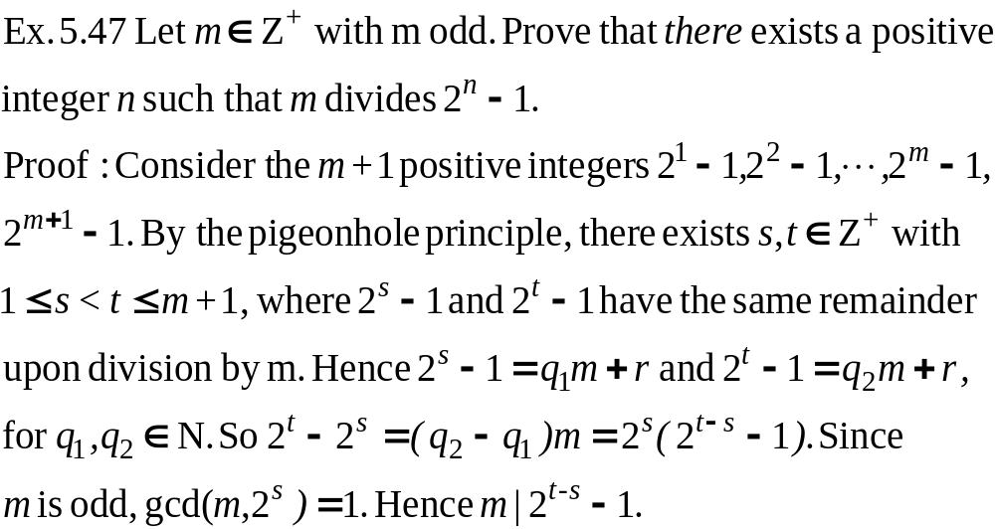
Chapter 5 Relations and Functions
5.5 The Pigeonhole Principle

Slide 38
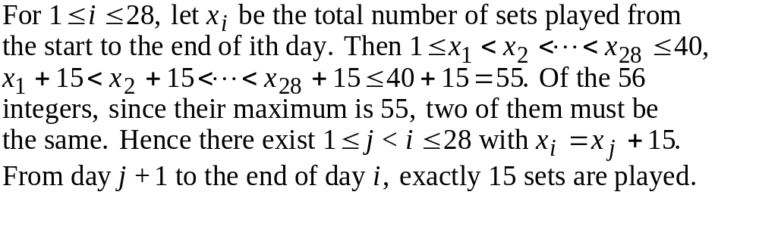
Chapter 5 Relations and Functions
5.5 The Pigeonhole Principle
Ex. 5.48 28 days to play at most 40 sets of tennis and at least 1
play per day. Prove there is a consecutive span of days during
which exactly 15 sets are played.

Slide 39
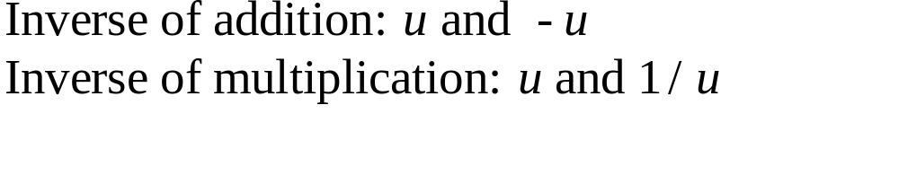


Chapter 5 Relations and Functions
5.6 Function Composition and Inverse Functions
Def 5.15 If f:A B, then f is said to be bijective, or to be a
one-to-one correspondence, if f is both one-to-one and onto.
Ex. 5.50
must be |A|=|B|
(if )
but could be
1
2
3
4
w
x
y
z
A
B

Slide 40
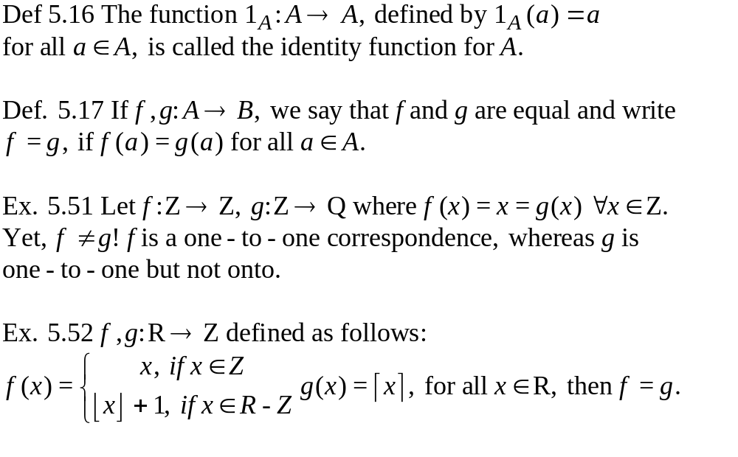
Chapter 5 Relations and Functions
5.6 Function Composition and Inverse Functions

Slide 41
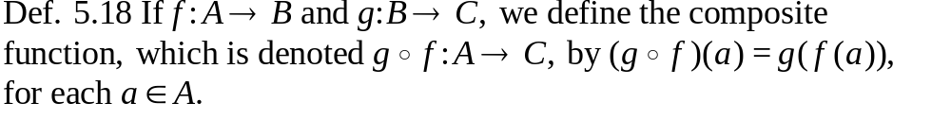
Chapter 5 Relations and Functions
5.6 Function Composition and Inverse Functions
Ex. 5.53
f
1
2
3
4
a
b
c
g
w
x
y
z
B
A
C

Slide 42
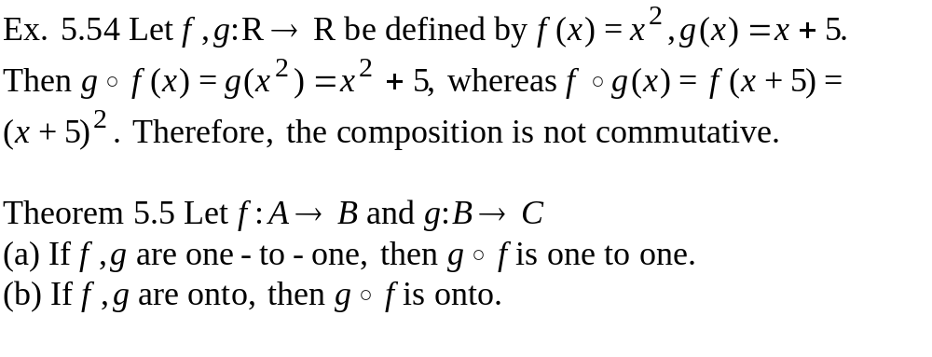
Chapter 5 Relations and Functions
5.6 Function Composition and Inverse Functions
f
g
A
B
C

Slide 43
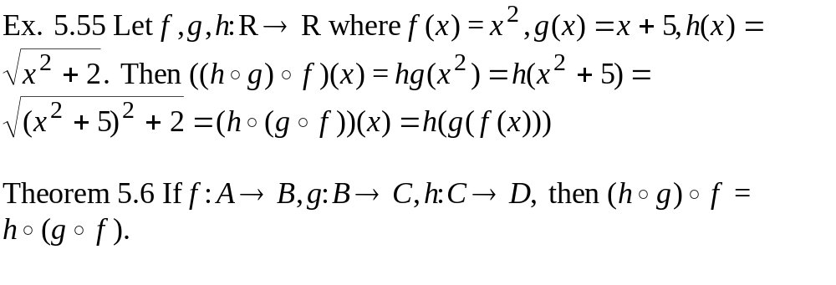
Chapter 5 Relations and Functions
5.6 Function Composition and Inverse Functions
h(gf)
gf
f
g
h
A
B
C
D
hg
(hg)f

Slide 44

Chapter 5 Relations and Functions
5.6 Function Composition and Inverse Functions
f
A
B
g

Slide 45

Chapter 5 Relations and Functions
5.6 Function Composition and Inverse Functions

Slide 46

Chapter 5 Relations and Functions
5.6 Function Composition and Inverse Functions

Slide 47

Chapter 5 Relations and Functions
5.6 Function Composition and Inverse Functions

Slide 48

Chapter 5 Relations and Functions
5.7 Computational Complexity
problem algorithm 1
algorithm 2
Which one is best?
We need measures.
algorithm k
time-complexity or space-complexity
a function f(n) where n is the size of the input
lower bounds, best cases, average cases, worst cases

Slide 49


Chapter 5 Relations and Functions
5.7 Computational Complexity
Big-Oh Form Name
O(1) constant
O(log₂n) Logarithmic
O(n) Linear
O(nlog₂n) nlog₂n
O(n²) Quadratic
O(n³) Cubic
O(n^{m}),m=0,1,2,3,... Polynomial
O(c^{n}),c>1 Exponential
O(n!) Factorial

Slide 50

Chapter 5 Relations and Functions
5.7 Computational Complexity
Order of Complexity
problem size n
log₂n n nlog₂n n² 2^{n} n!
2
1 2 2 4 4 2
16
4 16 64 256 6.5 10⁴ 2.1 10¹³
64
6 64 384 4096 1.84 10¹⁹ >10⁸⁹

Slide 51

Chapter 5 Relations and Functions
Summaries (m objects, n containers)
Objects Containers Some Number
Ar Are Containers of
Distinct Distinct May Be Empty Distributions
Yes Yes Yes
Yes Yes No
Yes No Yes
Yes No No
No Yes Yes
No Yes No
Put one object in each container first.

Slide 52


Chapter 5 Relations and Functions
Exercise. P230:27
P237: 6,18
P244: 14
P249: 18,20

